Slide 1
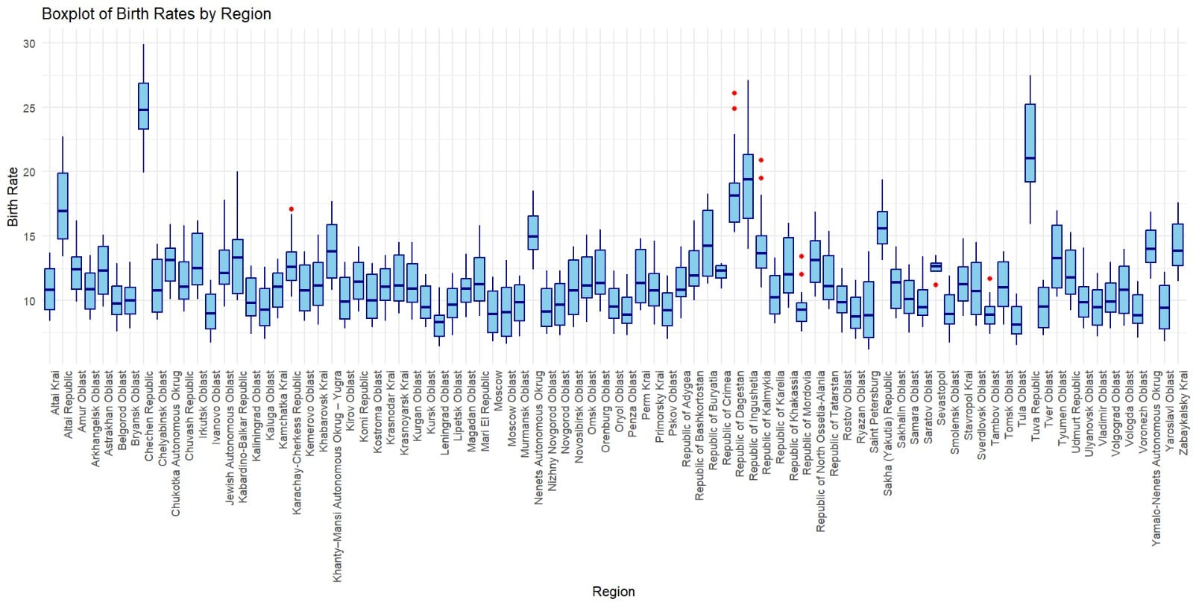
Interpreting the data, visualization analyzing trends,

Slide 2
Explanation of the boxplot of birth rates by region
1. Understanding the Chart
This is a boxplot showing the birth rates (on the Y-axis) for various regions (on the X-axis). Each region has its own boxplot, which summarizes how birth rates are distributed within that region.
Here’s a detailed explanation of the boxplot of birth rates by region in a clear, step-by-step manner:
2. Boxplot Components and Their Meaning
Each individual boxplot consists of these key elements:
a. The Box (Middle Portion):
Represents the Interquartile Range (IQR):
The bottom edge of the box is the 25th percentile (Q1).
The top edge of the box is the 75th percentile (Q3).
The height of the box shows the variability (spread) of birth rates for the middle 50% of the data in a region.

Slide 3

Visualization
A short box means birth rates are consistent; a taller box indicates more variation.
b. The Line in the Box (Median):
The horizontal line inside the box is the median, which is the middle value of the data for that region. Half the data points lie above it, and half lie below it.
c. The Whiskers:
The vertical lines extending from the box (whiskers) show the range of most of the data:
They usually extend up to 1.5 times the IQR above Q3 and below Q1.
Any points outside this range are considered outliers.
d. Red Dots (Outliers):
These are regions with birth rates significantly higher or lower than the rest of the data for that region.

Slide 4
Visualization
3. What the Chart Shows
The chart compares birth rate distributions across regions, helping you understand trends and variability. Here's what you can observe:
a. Median Birth Rates (Central Trends):
Look at where the median line falls in each box.
Some regions have higher medians (e.g., Republic of Tuva), indicating higher typical birth rates.
Others, like Moscow, may have lower medians, reflecting lower typical birth rates.
b. Variability (Spread of Birth Rates):
Tall boxes or long whiskers (e.g., Republic of Tuva, Dagestan) indicate more variability in birth rates within those regions.
Shorter boxes or whiskers suggest more uniform birth rates across the region.

Slide 5
Visualization
c. Outliers (Red Dots):
Regions with red dots have unusual birth rates, either much higher or lower than expected. For example, these might indicate rural communities with high birth rates or urban areas with declining populations.
4. Purpose of the Analysis
This visualization helps in:
a. Identifying Regional Trends:
Which regions have the highest and lowest birth rates?
For instance, Tuva appears to have some of the highest rates, while more urban regions like Moscow may show lower rates.

Slide 6
Visualization
b. Policy Insights:
Regions with higher birth rates may need more investment in childcare, schools, and healthcare.
Regions with low or declining birth rates may face aging population challenges or labor shortages.
c. Spotting Areas of Interest (Outliers):
Outliers (e.g., isolated high birth rates in certain areas) might warrant further study to understand why they deviate from the norm.
d. Comparing Variability:
Why do some regions have more stable birth rates, while others have wide fluctuations? This could be due to economic, cultural, or policy factors.

Slide 7
Visualization
5. Key Observations from the Chart
Regions with Higher Birth Rates:
Certain areas, such as Tuva and Dagestan, show both high medians and wide variability, indicating a mix of urban and rural influences or cultural factors encouraging larger families.
Regions with Low Birth Rates:
Urban areas like Moscow tend to have lower median birth rates, which could reflect urbanization, higher costs of living, or career-focused lifestyles.
Outliers:
Red dots scattered across regions indicate unique cases that stand out. For example, an outlier in Dagestan may represent a community with significantly higher birth rates than the rest.

Slide 8
Visualization
6. Next Steps
To interpret further:
Zoom in on regions of interest: Focus on areas with extreme values (e.g., outliers) or surprising trends.
Overlay other data: Compare with socioeconomic factors (e.g., income levels, urbanization) to explain patterns.
Policy focus: Use these insights to plan resources like schools, hospitals, or workforce strategies.

Slide 9
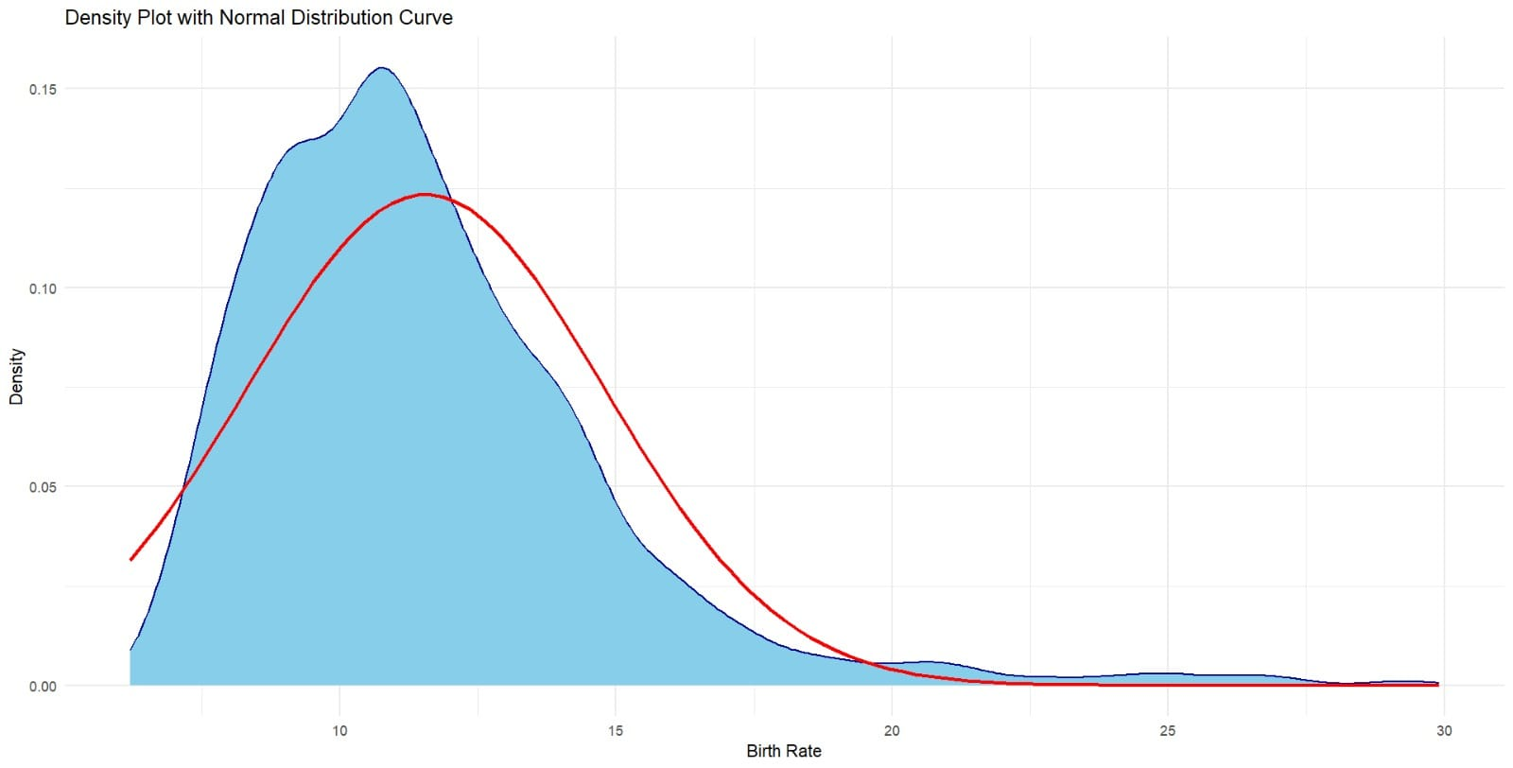
Density plot with normal distribution curve

Slide 10
1. Components of the Density Plot
X-Axis (Birth Rate): Represents the birth rate values (likely births per 1,000 people).
Y-Axis (Density): Represents the density or proportion of data points within a specific range of birth rates.
Shaded Area (Blue): The smooth, continuous curve shows the estimated density of the birth rates. Taller areas correspond to ranges of birth rates where data points are more concentrated.
Red Line (Normal Curve): Represents a theoretical normal distribution with similar mean and standard deviation to the actual data.
2. What the Plot Shows
The blue curve represents the actual distribution of birth rates in the dataset.
The red curve represents what the distribution would look like if the data were perfectly normal (bell-shaped).
Comparing the two curves allows us to assess how well the birth rates follow a normal distribution.

Slide 11
3. Key Observations
Peak of the Blue Curve:
The tallest part of the blue curve (mode) is around 10 to 12 birth rates, suggesting most regions have birth rates in this range.
Skewness:
The blue density curve is right-skewed, meaning there are some regions with much higher birth rates than the majority.
The long tail extending to the right (birth rates >20) indicates a few regions with very high birth rates compared to the norm.
Mismatch with Normal Distribution:
The red normal curve doesn't align perfectly with the blue curve, particularly in the right tail. This confirms that the birth rate distribution deviates from normality.
4. Interpretation
Most Common Birth Rates: Most regions have birth rates concentrated in the range of 10 to 12 births per 1,000 people.
Regions with High Birth Rates: A few regions exhibit exceptionally high birth rates, contributing to the right-skewed tail of the distribution.
Non-Normal Distribution: The actual data (blue curve) shows a skewed distribution, which may suggest underlying demographic, socioeconomic, or cultural factors influencing birth rates differently across regions.

Slide 12
5. Why is this Important?
This plot is likely being used to:
Visualize the spread of birth rates to identify central trends and variability.
Assess whether birth rates follow a normal distribution, which might be a statistical assumption for further analyses.
Highlight regions with unusually high or low birth rates that may need specific investigation or policy attention.
6. Next Steps
Further Analysis:
Explore why some regions have much higher birth rates.
Investigate the relationship between birth rates and factors like income, education, or urbanization.
Statistical Considerations:
If normality is required for analysis (e.g., t-tests), consider applying transformations (e.g., logarithmic) to make the data closer to normal.
Policy Insights:
Use this information to guide resource allocation, such as planning for schools, healthcare, or family planning services.

Slide 13
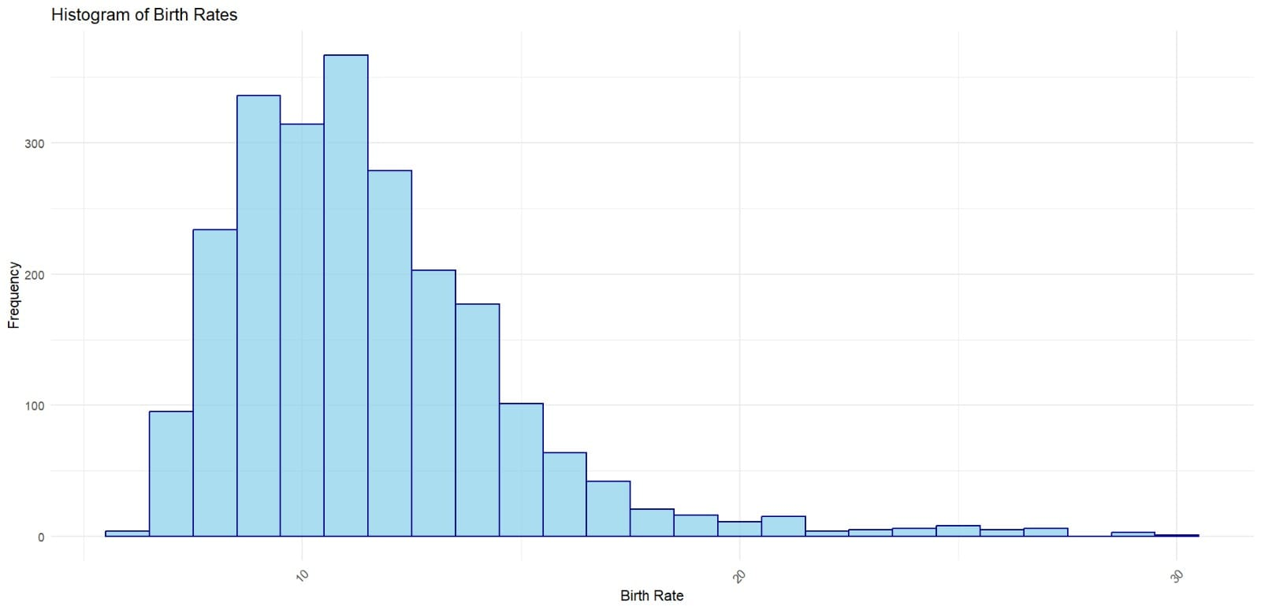
histogram of birth rates

Slide 14
This is a histogram of birth rates, which provides a visual representation of the frequency distribution of the data. Here’s a detailed breakdown of the plot:
1. Key Components
X-Axis (Birth Rate): Displays the range of birth rate values (e.g., births per 1,000 people).
Y-Axis (Frequency): Indicates how many regions fall within each range (bin) of birth rates.
Bars (Blue): Each bar represents a specific range of birth rates and the number of regions (frequency) within that range.
2. What the Histogram Shows
Most Frequent Birth Rates:
The tallest bars (highest frequencies) occur between 10 and 12 birth rates, indicating this is the most common range of birth rates among the regions in the dataset.
Skewness:
The histogram is right-skewed, with most regions having lower birth rates and fewer regions exhibiting higher birth rates.
The long tail to the right suggests there are regions with significantly higher birth rates compared to the majority.
Range of Values:
Birth rates primarily fall between 8 and 15, with some outliers extending up to 30.

Slide 15
3. Key Observations
Peak Frequency:
The mode (most frequent range) is between 10 and 12 births per 1,000 people.
Low Frequency at Extremes:
Very few regions have extremely low (less than 8) or high (greater than 20) birth rates.
Outliers:
The histogram hints at the presence of outliers in the data, visible in the small bars at higher birth rate values (above 20).
4. Interpretation
This histogram is useful for understanding the distribution of birth rates across regions.
The right skewness may indicate that while most regions have similar birth rates, there are a few regions with factors (e.g., demographics, policies, culture) contributing to exceptionally high birth rates.
Identifying the mode (most frequent range) provides insight into typical regional birth rates.

Slide 16
5. Next Steps for Analysis
Outlier Analysis: Investigate regions with birth rates significantly higher than the norm to understand the contributing factors.
Skewness Correction: If further statistical analysis requires normality, consider transforming the data to reduce skewness.
Comparative Analysis: Compare birth rate distributions across different subgroups (e.g., urban vs. rural regions, socioeconomic classes) to identify patterns.

Slide 17
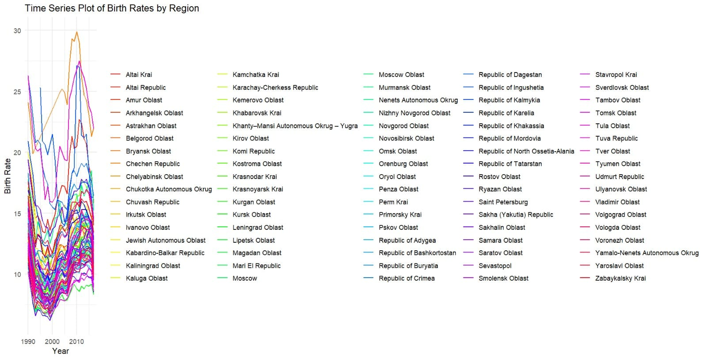
time series plot of birth rates by region,

Slide 18
This chart is a time series plot of birth rates by region, illustrating how the birth rates have changed over time (from 1990 to approximately 2015) across different regions. Here's a detailed explanation:
1. Key Components
X-Axis (Year):
Represents the timeline, showing years from around 1990 to 2015.
Y-Axis (Birth Rate):
Shows the birth rate values (likely births per 1,000 people).
Lines (Colored by Region):
Each line corresponds to a specific region, with birth rate trends over time. The legend lists the regions and their associated line colors.

Slide 19
2. What the Plot Shows
Trends:
Many regions show a decline in birth rates in the 1990s, followed by a gradual recovery or increase in the 2000s.
Regional Differences:
Some regions have significantly higher birth rates (e.g., Republic of Ingushetia, Chechen Republic) compared to others, where the rates are consistently lower.
Peak Period:
A few regions show notable peaks in birth rates during certain years (e.g., between 2005-2010).
Variability Across Regions:
The variability in trends highlights demographic, economic, or policy-related differences impacting birth rates.

Slide 20
3. Key Observations
Post-Soviet Decline:
Many regions experience a sharp drop in birth rates during the early 1990s, coinciding with the economic and social turmoil following the dissolution of the Soviet Union.
Recovery Phase:
In the 2000s, birth rates in many regions begin to recover, potentially reflecting stabilization in social and economic conditions and government incentives to encourage childbirth.
Outlier Regions:
Some regions, such as the Chechen Republic and Republic of Ingushetia, show higher and more stable birth rates, likely influenced by cultural and socio-economic factors.
Fluctuations:
There are visible fluctuations in some regions, with birth rates spiking and falling multiple times, possibly reflecting short-term policy changes, crises, or natural population dynamics.

Slide 21
4. Interpretation
Common Trends Across Regions:
The sharp dip in the 1990s followed by recovery is a shared pattern, but the magnitude and recovery rate differ among regions.
Impact of Policies:
The recovery in birth rates during the 2000s may reflect governmental family policies, financial support for families, or cultural influences.
Regional Disparities:
The diversity in trends underscores the varying socio-economic, cultural, and policy environments across the regions.

Slide 22
5. Next Steps for Analysis
Regional Comparison:
Focus on specific regions with higher or lower trends to identify the factors influencing these differences.
Policy Impact Analysis:
Investigate whether specific family or demographic policies introduced in certain years correlate with birth rate changes.
Time Intervals:
Break the data into shorter intervals (e.g., 5-year periods) to analyze changes in greater detail.

Slide 23
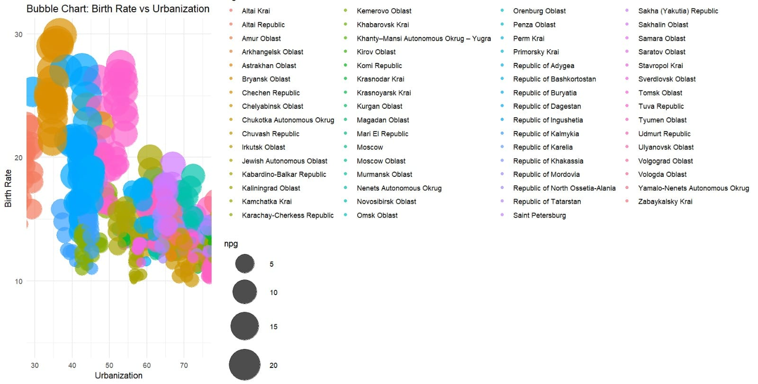
Bubble chart birth rates and urbanization

Slide 24
This is a bubble chart that visualizes the relationship between birth rates and urbanization levels across different regions. Here's a detailed breakdown:
1. Key Chart Elements
X-Axis (Urbanization):
Represents the percentage of urbanization in each region, likely measured as the proportion of the population living in urban areas.
Y-Axis (Birth Rate):
Represents the birth rate values, likely measured as births per 1,000 people.
Bubbles:
Each bubble represents a region, with:
Size (npg): Corresponding to a third variable, possibly population or another demographic measure.
Color: Indicating different regions, as per the legend.

Slide 25
2. Insights from the Chart
Negative Correlation:
As urbanization increases, birth rates tend to decrease. This pattern reflects common demographic trends where urbanized regions generally have lower fertility rates.
Outliers:
Certain regions maintain higher birth rates despite high urbanization levels, possibly influenced by cultural or policy factors.
Variation in Bubble Size:
Larger bubbles likely represent regions with larger populations or higher significance in the measured variable (npg).
Clusters:
Regions tend to cluster based on urbanization and birth rates, suggesting that regions with similar levels of urbanization exhibit similar birth rate trends.
3. Key Observations
High Urbanization & Low Birth Rates:
Regions with over 70% urbanization (e.g., Moscow) tend to have lower birth rates, often below 15.
Low Urbanization & High Birth Rates:
Regions with lower urbanization (e.g., certain republics) often exhibit higher birth rates, sometimes exceeding 25.
Transition Zones:
Regions in the middle range of urbanization (40-60%) show a mix of trends, highlighting transitional demographic behaviors.
Regional Influence:
The color-coded legend shows that regions with similar cultures or policies might cluster together.

Slide 26
4. Potential Factors Behind Trends
Urbanization Impact:
Urban areas often have better access to education, employment, and healthcare, leading to lower fertility rates.
Cultural Influence:
Regions with strong cultural or religious norms may resist the decline in birth rates despite urbanization.
Government Policies:
Family and demographic policies can affect the trends significantly, either incentivizing or discouraging higher birth rates.
5. Future Analysis
Focus on Outliers:
Study regions that deviate from the trend to understand what influences their unique behavior.
Detailed Analysis by Size:
Explore the significance of bubble size (npg) in relation to the trends.
Temporal Trends:
If data over time is available, examine how urbanization and birth rate relationships have evolved.

